Slide 1
AJAY Y
REGISTER NO:211521104005
COMPUTER SCIENCE AND ENGINEERING
3/21/2024 Annual Review

Slide 2
PROJECT TITLE
DOG VS CAT CLASSIFICATION

Slide 3


AGENDA
Problem Statement
Project Overview
End Users
Our Solution and Proposition
Key Features
Modelling Approach
Results and Evaluation
Conclusion
3/21/2024 Annual Review

Slide 4

PROBLEM STATEMENT
Introduction to the problem: Classifying images of dogs and cats accurately.
Discuss the relevance: Identifying animals in images is crucial for various applications, such as pet identification, animal monitoring, and veterinary diagnostics.
Challenges: Distinguishing between similar features of dogs and cats, variability in poses, lighting conditions, and backgrounds.

Slide 5

PROJECT OVERVIEW
Objective: To develop a Convolutional Neural Network (CNN) model for accurate classification of images into two categories: dogs and cats.
Importance: Enhancing image classification accuracy using deep learning techniques.
Scope: Training and testing the model on a dataset of labeled images of dogs and cats.

Slide 6
WHO ARE THE END USERS?
Pet Owners: Interested in easily identifying their pets in images.
Animal Shelters: Facilitate the adoption process by quickly identifying the breed of animals.
Veterinarians: Aid in diagnosing medical conditions based on images.
3/21/2024 Annual Review

Slide 7

OUR SOLUTION AND ITS VALUE PROPOSITION
Introduction to our approach: Utilizing Convolutional Neural Networks (CNNs), a class of deep learning algorithms known for their effectiveness in image classification tasks.
Proposition: Our model aims to achieve high accuracy in classifying images of dogs and cats, providing a reliable tool for various stakeholders.

Slide 8

THE WOW IN OUR SOLUTION
Training on a large dataset: Leveraging a diverse dataset of labeled images for robust model training.
Utilization of CNN architecture: Implementing state-of-the-art CNN architectures for feature extraction and classification.
Data augmentation: Employing techniques like rotation, flipping, and zooming to enhance model generalization.
Model interpretability: Providing insights into the decision-making process of the model through visualization techniques.
3/21/2024 Annual Review
8

Slide 9
MODELLING
Data Preprocessing: Explaining steps such as resizing images, normalization, and data augmentation.
CNN Architecture: Description of the layers used in the model, such as convolutional, pooling, and fully connected layers.
Training Process: Overview of the training process including optimization techniques and hyperparameter tuning.
9

Slide 10
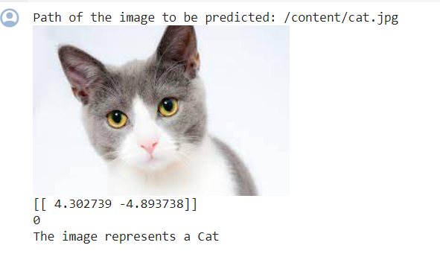
RESULTS
10

Slide 11
CONCLUSION
Our project successfully developed a Convolutional Neural Network (CNN) model that accurately classifies images of dogs and cats. Moving forward, we see potential for further refinement, dataset expansion, and the extension of our classification capabilities to encompass a broader range of animal species.

